Slide 1

ECG-BASED INDICATORS OF UNDERLYING CARDIAC DISEASE AND ARRHYTHMIA PRESENCE
TARA ALLRED, KELVIN OPARE, JOSHUA KRAUS, QUEREN ALCANTARA, AMMON PRICE
Notes:
Tara

Slide 2
DATASET OVERVIEW
Source: UCI Arrhythmia Dataset
452 Patients
279 ECG features
16 Diagnostic Classes
Includes:
Demographics (age, sex)
ECG waveform measurements
Add visual?
Notes:
Ammon
Alright, so to answer our research question, we worked with the UCI Arrhythmia dataset.
This dataset includes 452 patients, each with a really high number of features—279 ECG measurements—which capture different aspects of cardiac electrical activity.
It also includes 16 diagnostic classes, ranging from normal heart rhythms to various arrhythmia types.
In addition to ECG data, we also have basic demographic information like age and sex, which helps provide some clinical context.
Overall, this is a high-dimensional and complex dataset, which makes it great for analysis—but also introduces challenges that we had to address during preprocessing.”

Slide 3
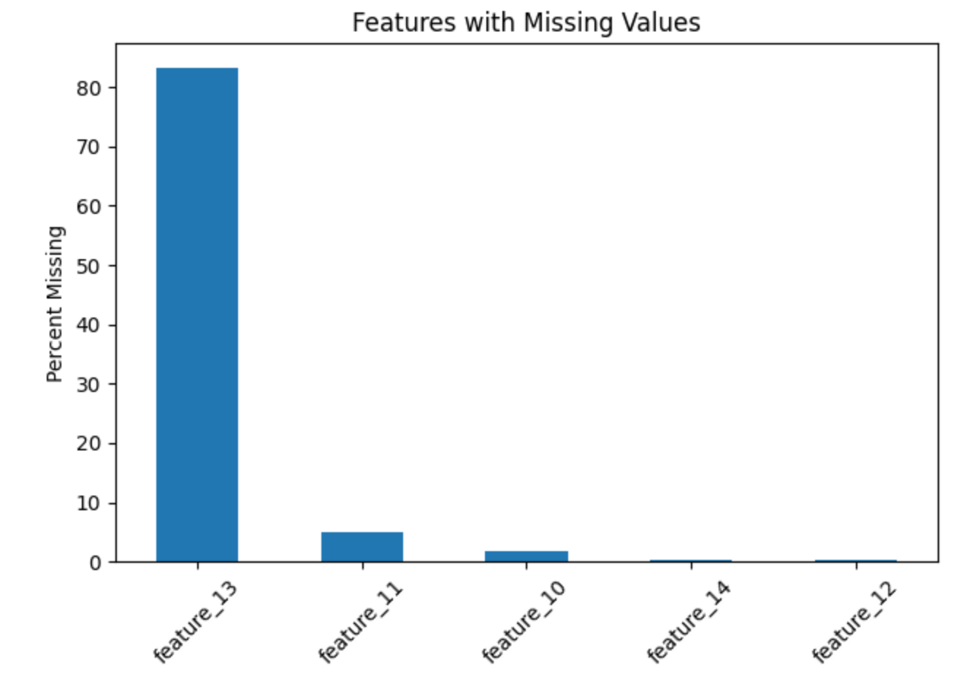
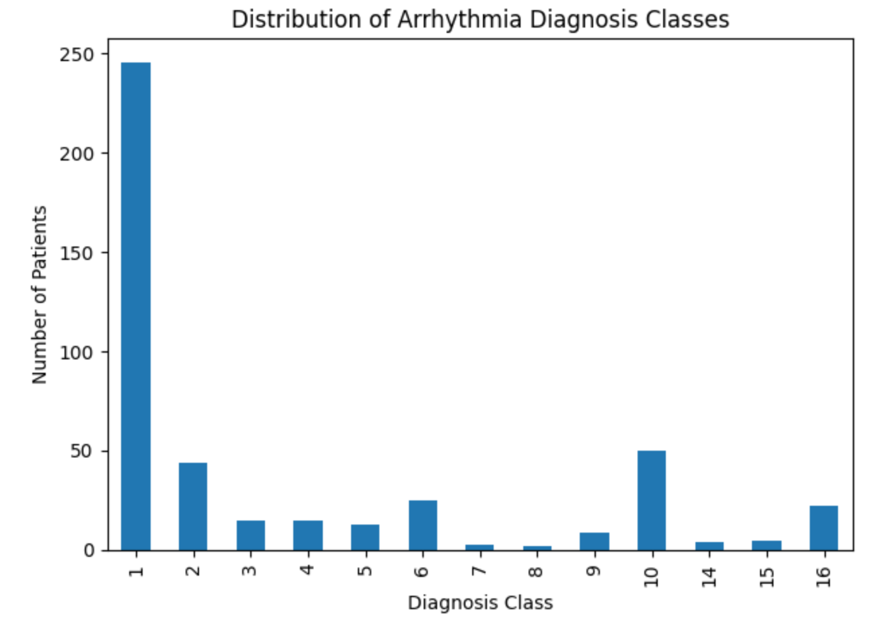
Dataset Overview Issues
Notes:
Ammon

Slide 4
OBJECTIVE: WHAT ARE WE TRYING TO DO
Analyze ECG-derived features to identify arrhythmia presence
Explore patterns across arrhythmia subtypes
Determine if features can distinguish normal rhythm vs arrhythmia
Evaluate if data supports predictive modeling
Notes:
Ammon
“So now that we’ve looked at the dataset, our main objective was to understand whether ECG-derived features can actually help identify arrhythmia.
First, we focused on analyzing these ECG features to detect whether an arrhythmia is present at all.
From there, we explored whether patterns exist across different arrhythmia subtypes, since not all arrhythmias present the same way.
We also wanted to determine if these features could clearly distinguish between normal heart rhythms and abnormal ones.
And finally, we evaluated whether the dataset was strong enough to support predictive modeling—essentially asking, can we use this data to reliably classify patients?”
🔥 Clean closing line:
“So overall, the goal was not just to explore the data, but to see if it could actually support meaningful, real-world prediction.”

Slide 5
HOW WE EVALUATED DATA QUALITY
Using Weiskopf & Weng framework:
Completeness → missing data analysis
Plausibility → realistic ECG values
Concordance → alignment across variables
Currency → dataset structure consistency
Notes:
Tara
“Before doing any analysis, we needed to make sure the dataset was actually reliable to work with.
To do that, we used a data quality framework from Weiskopf and Weng, which breaks data quality down into a few key dimensions.
First, we looked at completeness, which means identifying missing data and understanding how much of it we’re dealing with.
Next, we assessed plausibility, making sure the ECG values actually make sense clinically and fall within realistic ranges.
We also looked at concordance, which is basically checking that variables align properly with each other—so nothing is contradicting or mismatched.
And finally, we evaluated currency, meaning the dataset is structured consistently and organized in a way that supports analysis.
Together, these steps helped us determine whether the data was solid enough to move forward with modeling.”

Slide 6
KEY FINDINGS – DATA QUALITY
Most variables had high completeness
Some ECG features had significant missingness
No duplicate records; ECG values were physiologically plausible
Dataset structurally sound but required significant preprocessing
Notes:
Tara
“From our data quality assessment, a few key findings stood out.
First, most variables showed high completeness, meaning the dataset overall had a strong foundation to work with.
However, some ECG features did have significant missingness, which required us to be more intentional in how we handled those variables during preprocessing.
We also confirmed that there were no duplicate records, and importantly, the ECG values themselves were physiologically plausible—so nothing looked unrealistic or clinically impossible.
Overall, the dataset was structurally sound, but it wasn’t analysis-ready. It required significant preprocessing before we could confidently move into modeling.”
🔥 Strong closing line
“And these findings directly guided how we approached data cleaning and feature selection moving forward.”

Slide 7
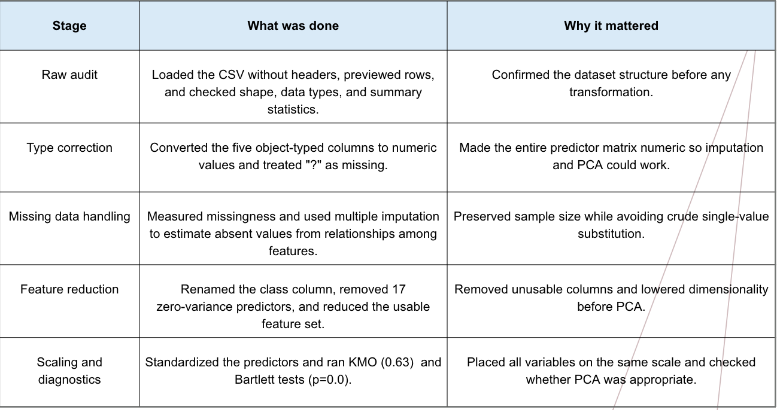
DATA CLEANING AND PREPROCESSING
Notes:
Tara

Slide 8
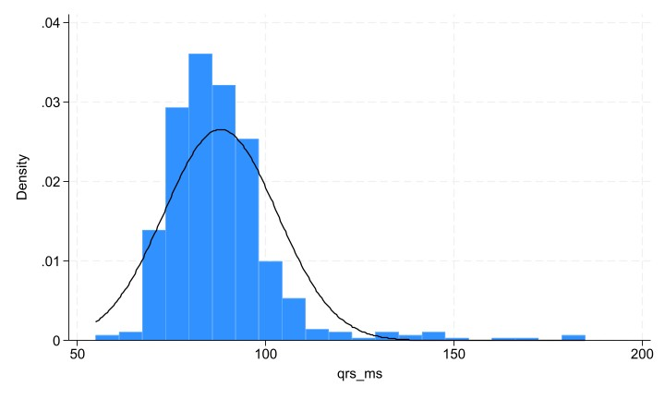
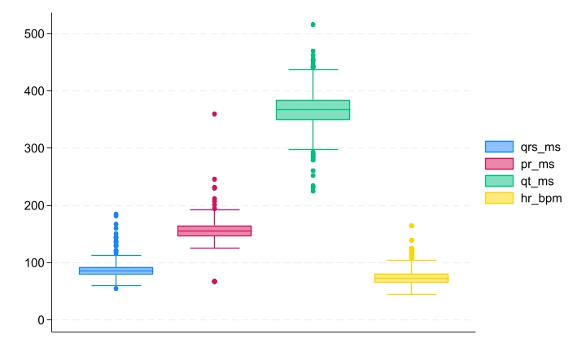
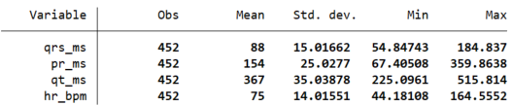
Statistical Analysis
For Age, the mean was 46.47, and the standard deviation was 16.488. The youngest age (min) was 0.93 yrs old, and the oldest (max) was 83.04 yrs old. With an IQR of 22.03.
Notes:
Joshua

Slide 9
MODELING APPROACH
Logistic Regression (baseline, interpretable)
Decision Tree (rule-based, visual)
Random Forest (ensemble, reduces overfitting)
Notes:
Tara
After preprocessing the data, we moved into modeling to evaluate whether ECG features could actually predict arrhythmia.
We started with logistic regression as our baseline model. It’s simple, highly interpretable, and gives us a clear understanding of how features relate to the outcome.
Next, we used a decision tree, which classifies data through a series of rule-based splits. This model is easy to visualize and helps highlight how different features influence classification.
Finally, we applied a random forest, which builds on decision trees by combining multiple trees. This helps improve stability and reduces the risk of overfitting, especially with high-dimensional data like ours.
Together, these three models allowed us to compare performance across both simple and more complex approaches.”
“This approach helped us evaluate not just accuracy, but also interpretability and model complexity. -- simple comparison to see how it all works

Slide 10
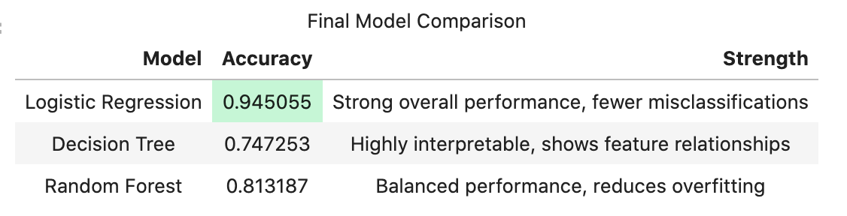
MODEL PERFORMANCE
Notes:
Tara
“Here we’re comparing the performance of our three models.
Starting with logistic regression, this model achieved the highest accuracy at about 94.5%, with fewer misclassifications overall. This suggests that the relationship between ECG features and arrhythmia can actually be captured pretty effectively with a simpler model.
The decision tree performed lower, with an accuracy around 74.7%. While it’s highly interpretable and useful for visualizing feature relationships, it likely oversimplified the complexity of the data.
The random forest improved on that, reaching about 81.3% accuracy. By combining multiple trees, it reduced overfitting and gave more balanced performance—but still didn’t outperform logistic regression.
So overall, logistic regression ended up being the most reliable model for this dataset.”
“This was a bit unexpected, but it highlights that simpler, more interpretable models can sometimes outperform more complex ones—especially when the data is well-preprocessed.”

Slide 11
KEY TAKEAWAYS + CONCLUSION
Back to our goal:
Perform data wrangling in the UCI Arrhytmia dataset to identify the features that could be used to identify arrhythmia.
Steps we performed:
Data assessment and data cleaning, statistical analysis
What we achieved:
Improved the dataset and labeling of classes for dimensionality reduction
Logistic Regression demonstrated successful modeling (distinguish normal rhythm vs arrhythmia) for downstream analysis
Notes:
Queren

